Slide 1

Welcome to HEMANTH Nutrition PLAN
HEMANTH REDDY SEDABAVI
ID: 19001177

Slide 2
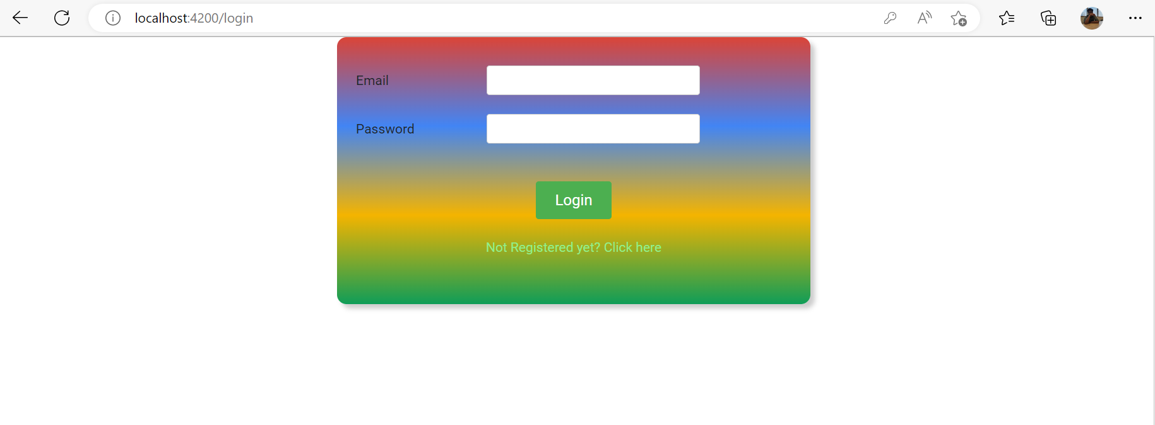
LOGIN PAGE User Admin

Slide 3
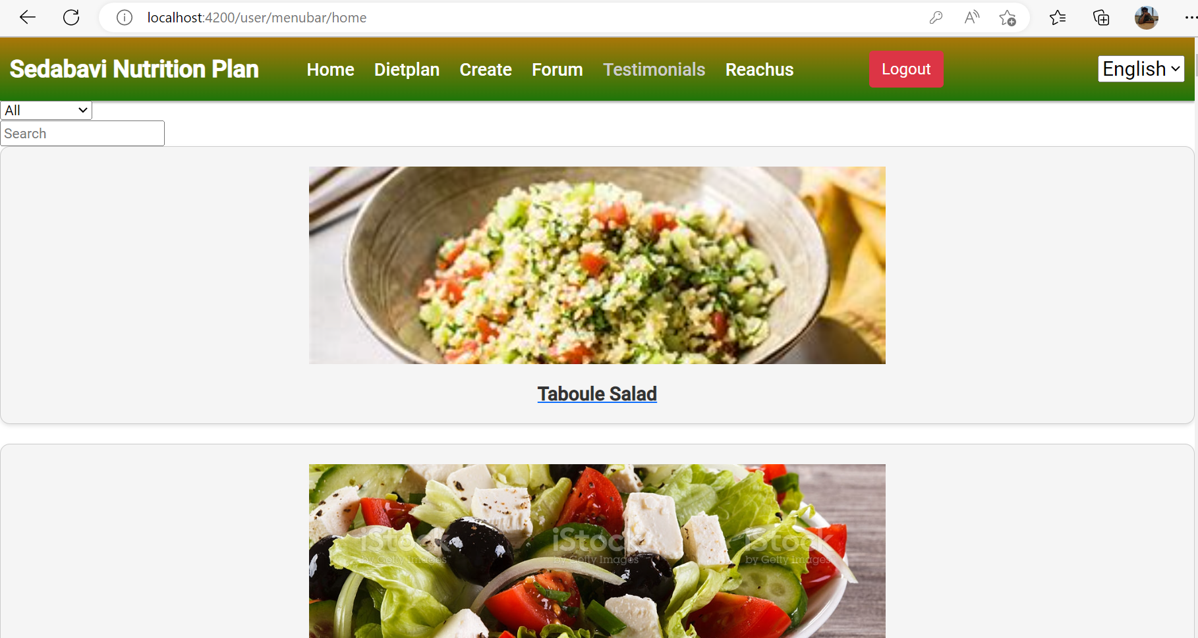
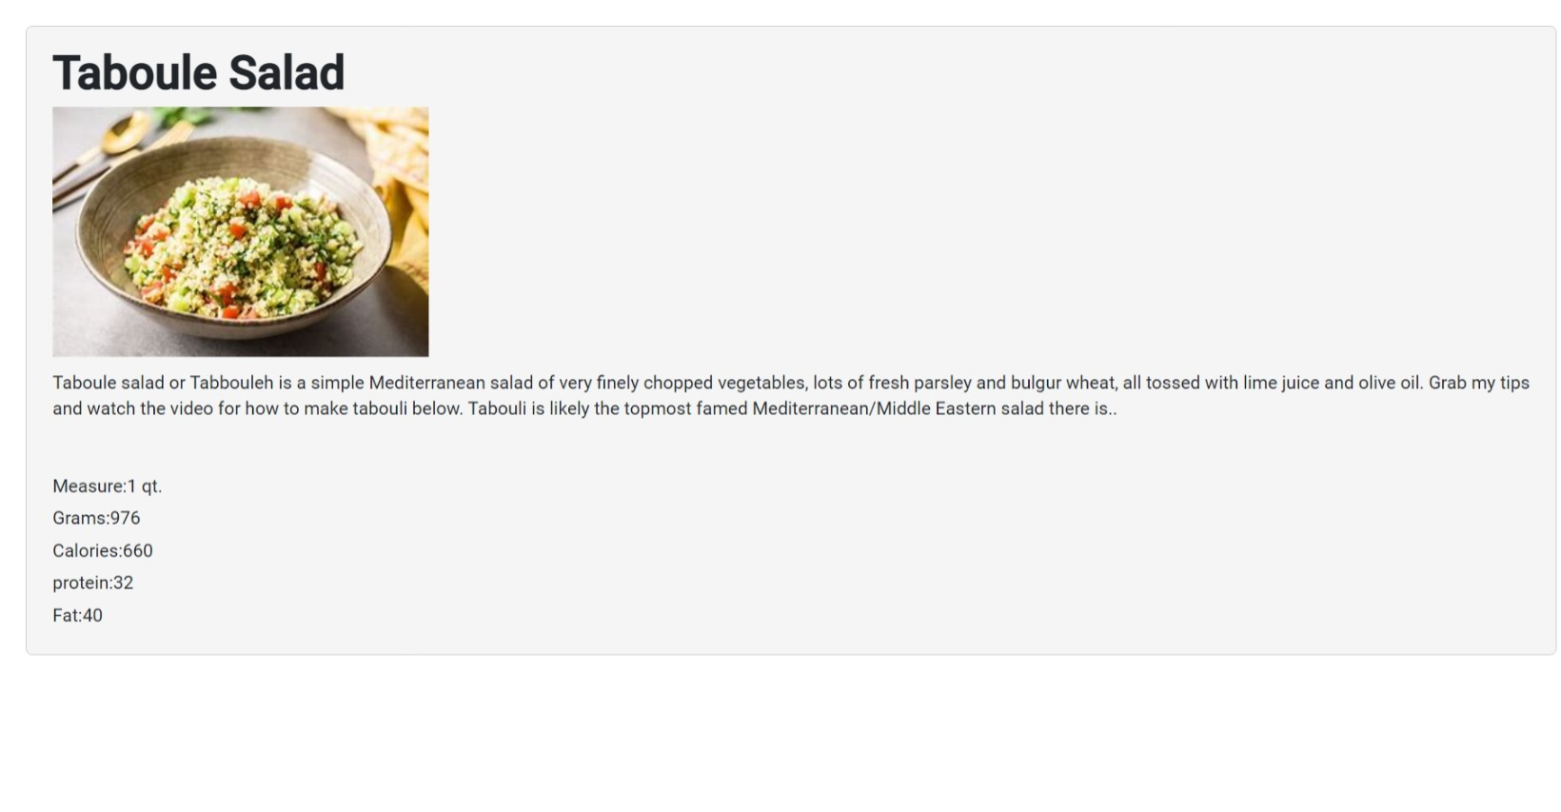
HOME
On the user page, there are several options including Home, Diet, Suggestions, Plan, Forum, and Logout.
The Home page features details about different items in the product section, which can be searched and filtered. Additionally, a translate language option has been included.
Clicking on any product will take the user to a separate page with more details.

Slide 4
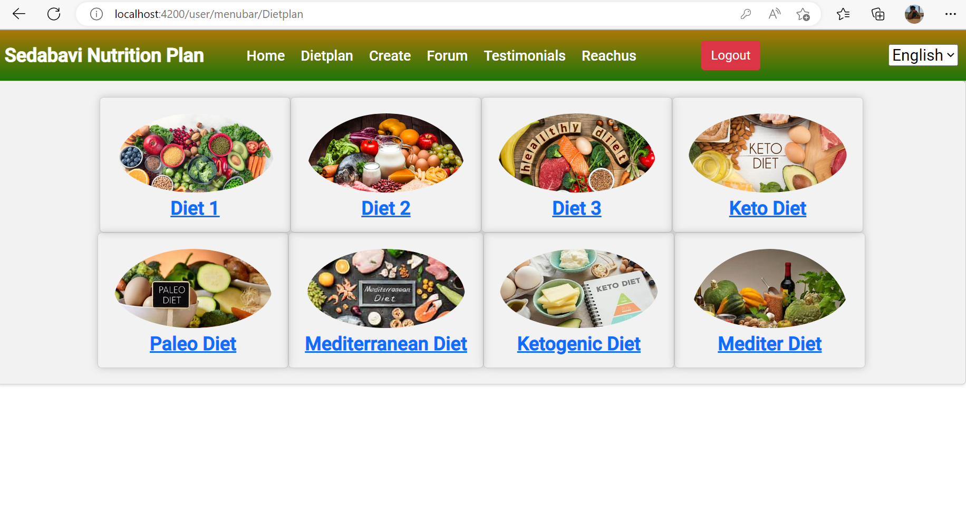
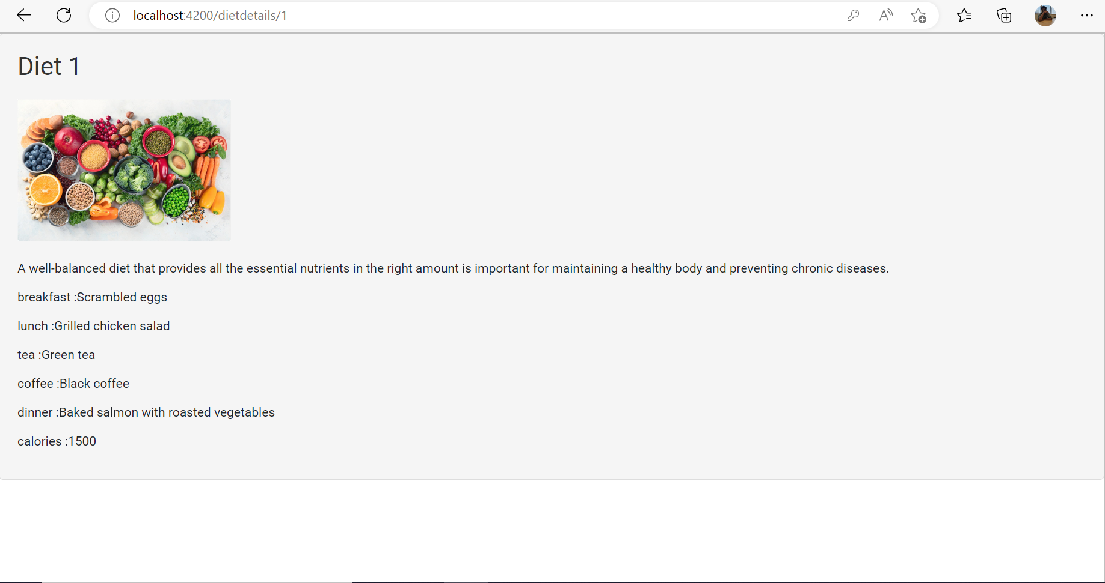
DIETPLAN
•This page displays different diet plans.
•If you click on any of the diet plans, it will show the details.
•When you click on any of the diet plans, it will display details such as this.

Slide 5
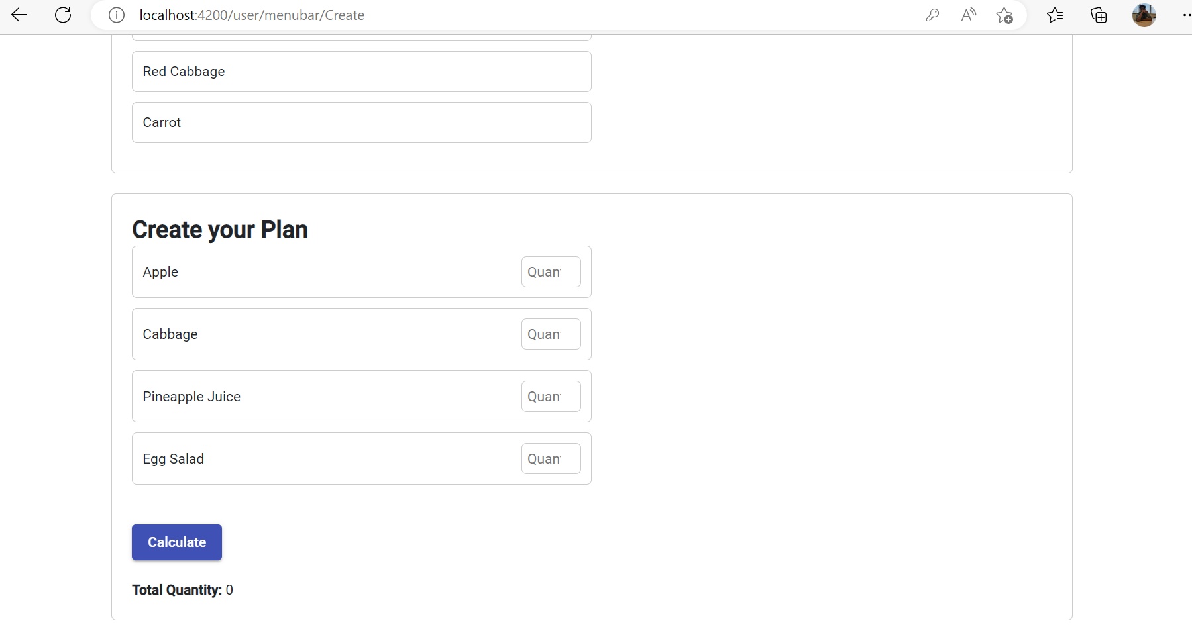
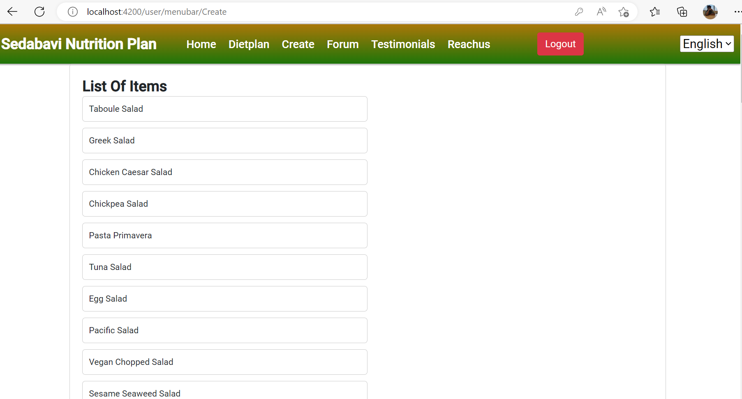
CREATE
1
• On the suggestion page, users can submit their questions and the admin can respond to them. Users can also view comments related to the questions.
• Clicking on any of the questions will display the comments within that question.

Slide 6
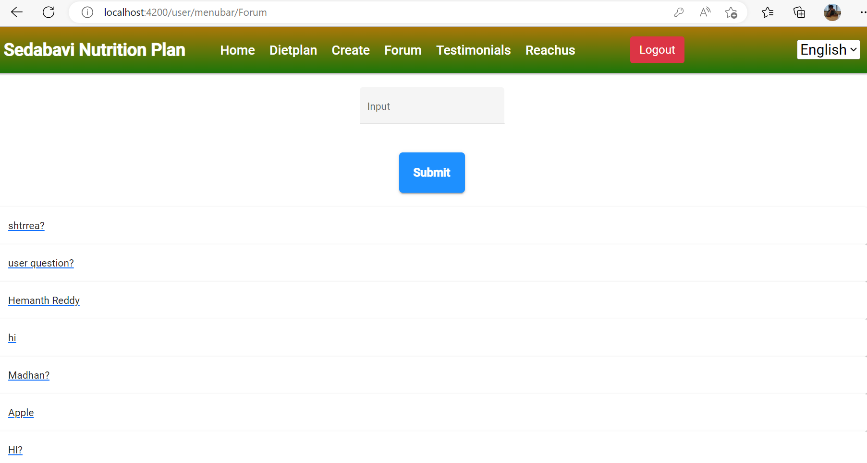
FORUM
• This forum allows both admin and users to access questions and comments.
• Users can post their queries and the admin can respond to the queries or users can answer the questions.
• The type box has added validation.

Slide 7
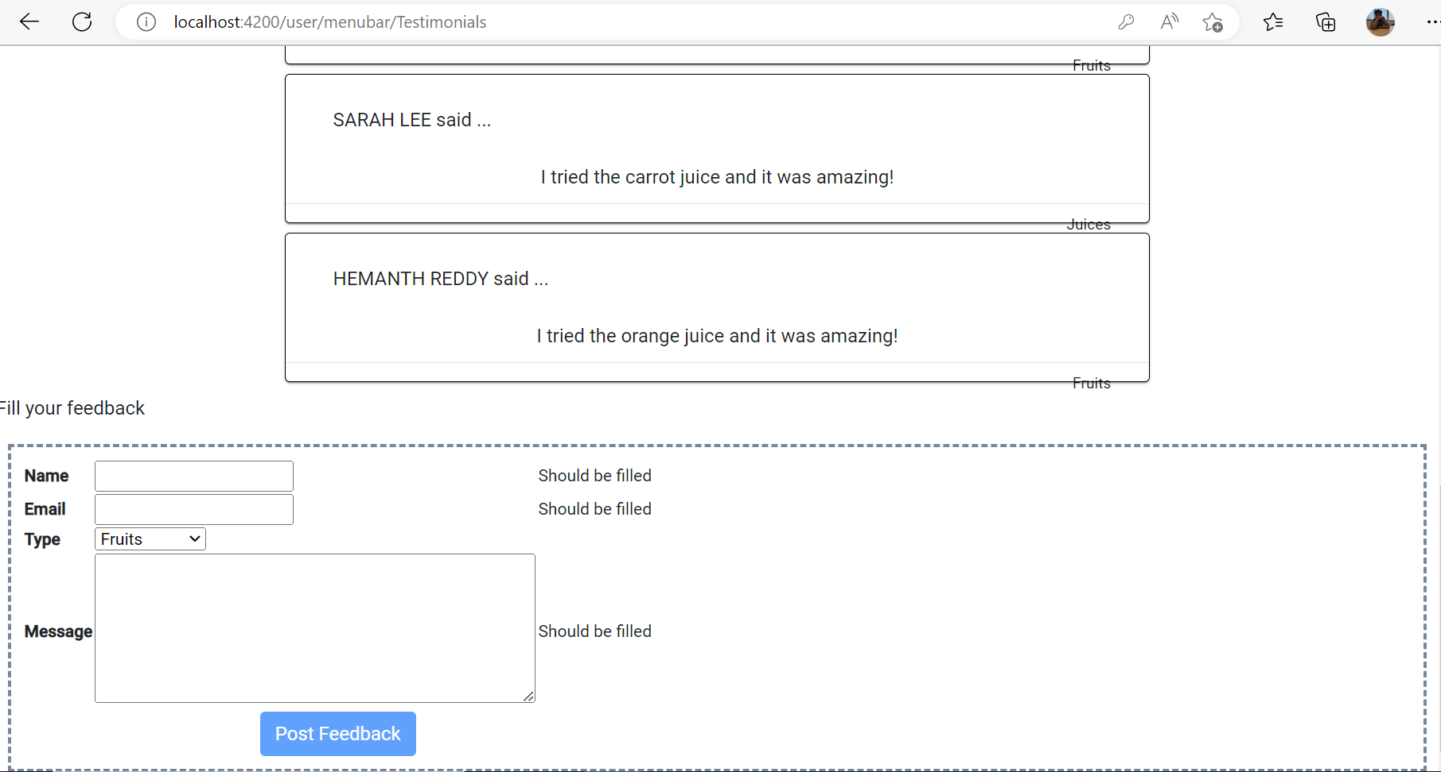
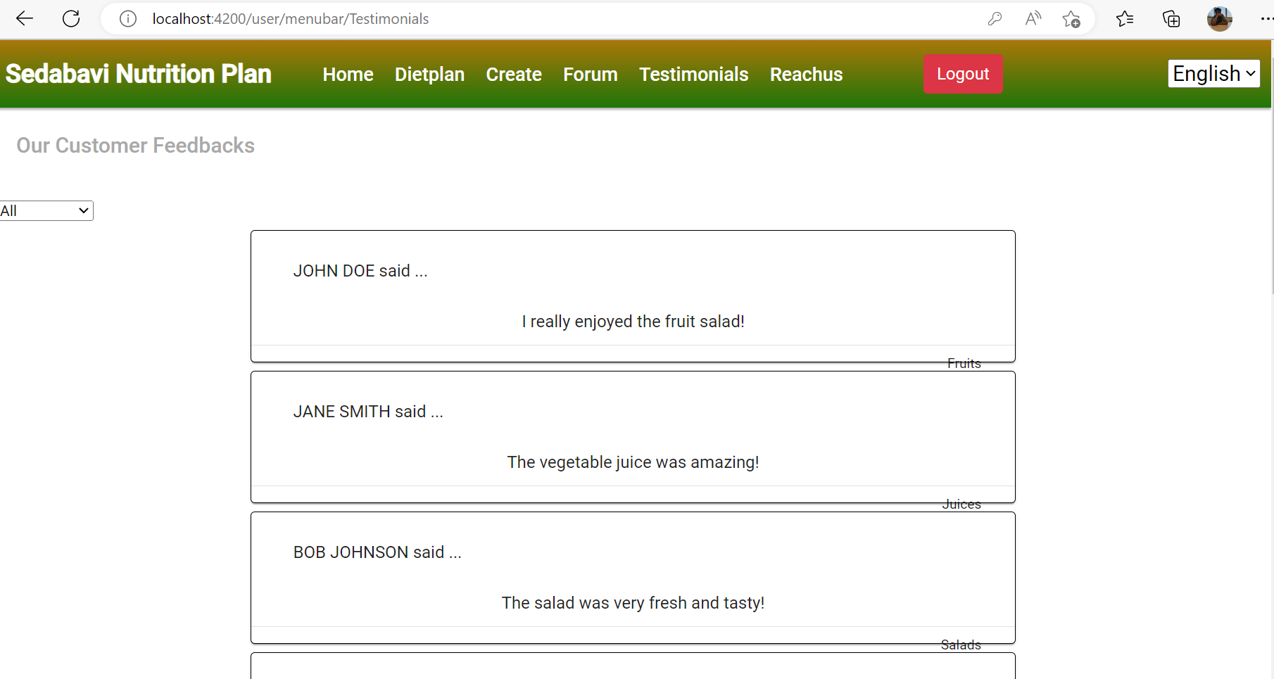
Testimonials
Testimonials are a form of feedback provided by customers or clients, often used to promote a product or service.
They can take the form of written statements, reviews testimonials.
Testimonials are a powerful marketing tool because they provide social proof that a product or service is effective and trustworthy.
Companies often feature testimonials on their website or in their advertising to attract new customers and build trust with existing ones.

Slide 8
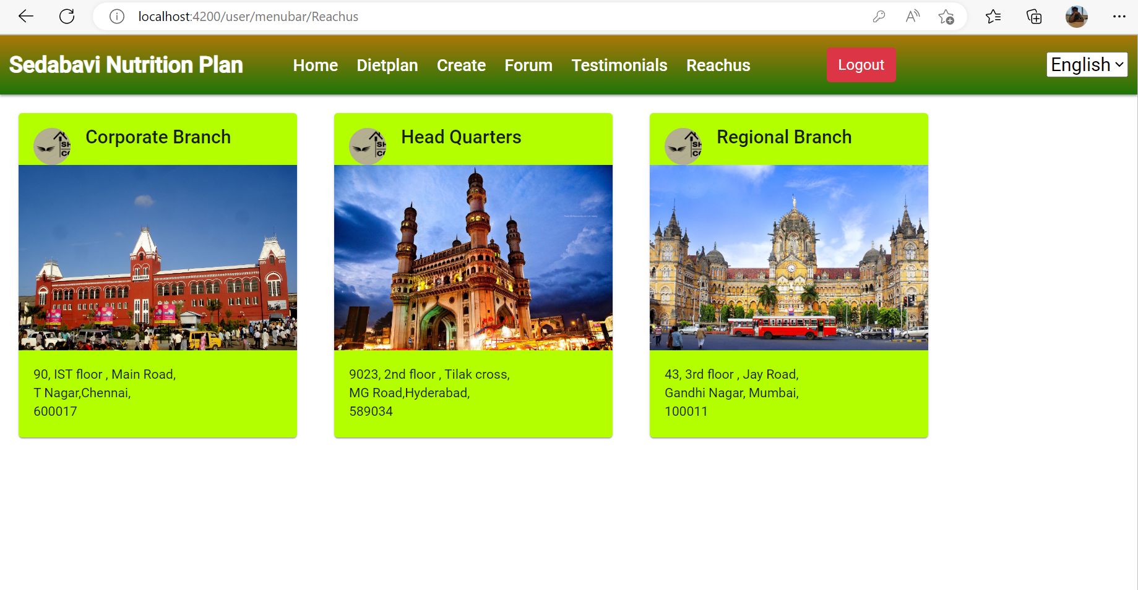
REACHUS
The Reach Us page typically contains contact information for a business or organization, such as their address, phone number, email, and social media handles.
This page may also include a contact form or map to the business location. The purpose of the Reach Us page is to make it easy for customers or users to get in touch with the business if they have any questions or concerns.

Slide 9
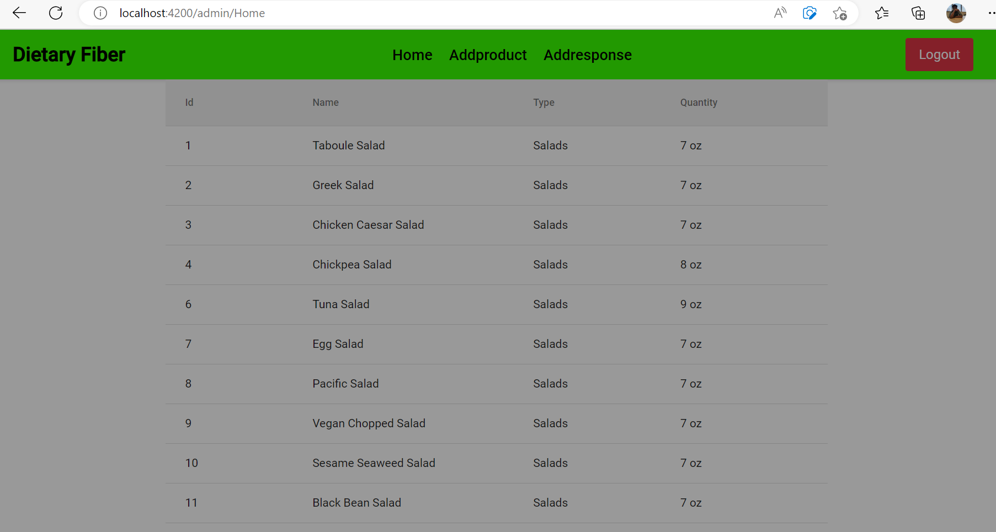
ADMIN HOME
List of details showing in home page

Slide 10
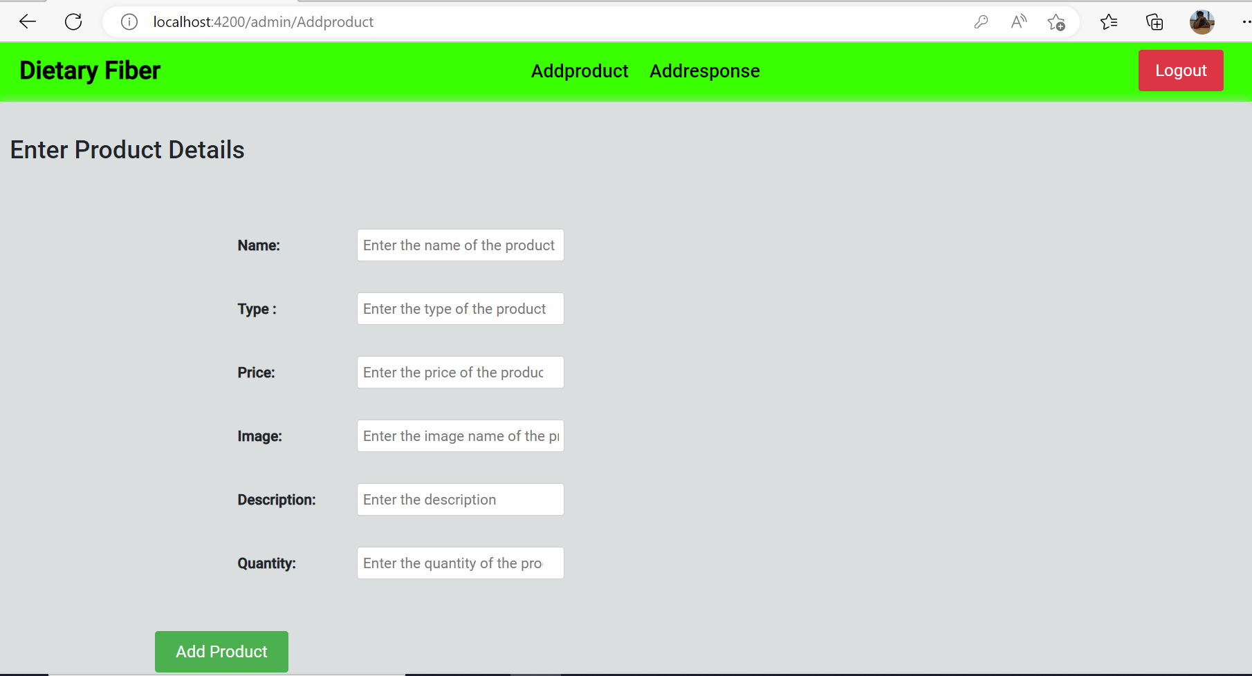
ADDPRODUCT
On the admin page, the administrator can add new products and responses. The filter pipe is also available on the page.
When the "Add Product" button is clicked, a new page opens where products can be added along with their protein values and other nutritional information.

Slide 11
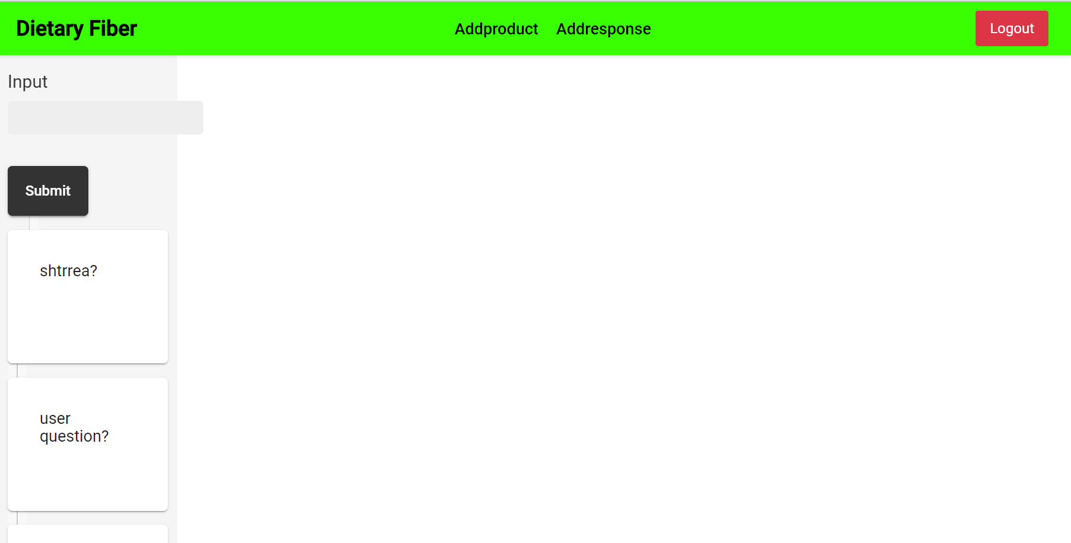
ADDRESPONSE
On the "Add Responses" page, the admin can add responses to questions that have been submitted by users.
If any question is clicked, it will prompt for comments related to that question.
In the comments section, multiple comments are displayed and the admin can add responses for each question.

Slide 12
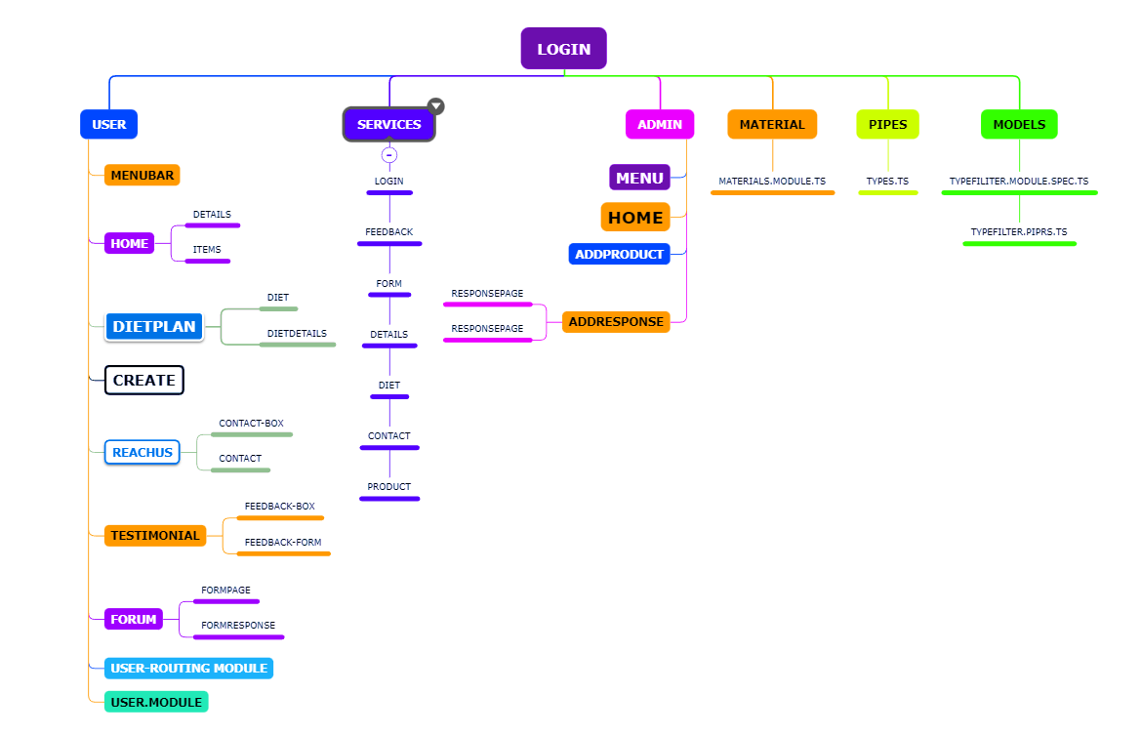
FLOWDIAGRAM

Slide 13


